Slide 1
B-Trees Operation
By: Aditya Tiwari
Assistant Professor
CSVTU, Bhilai

Slide 2
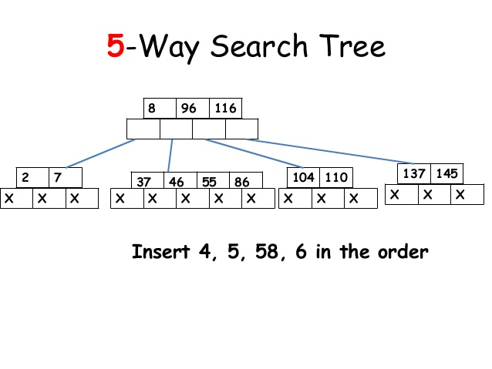

Slide 3
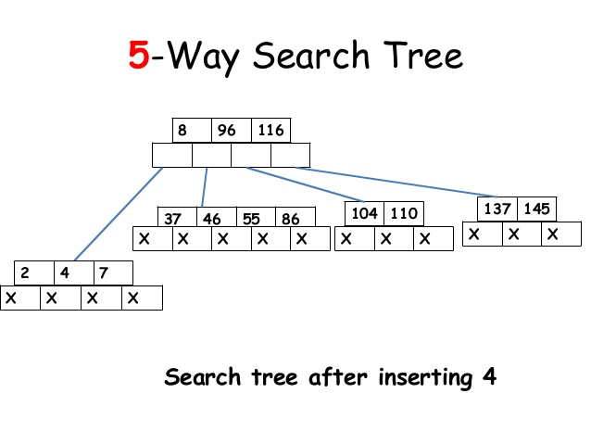

Slide 4
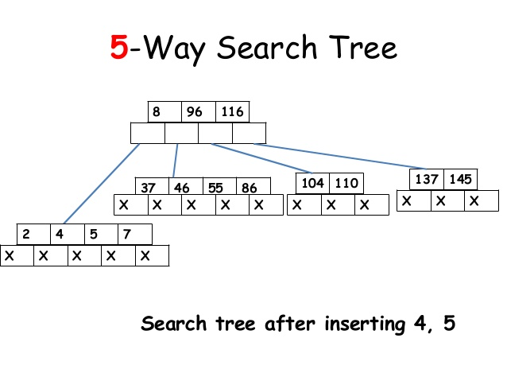

Slide 5
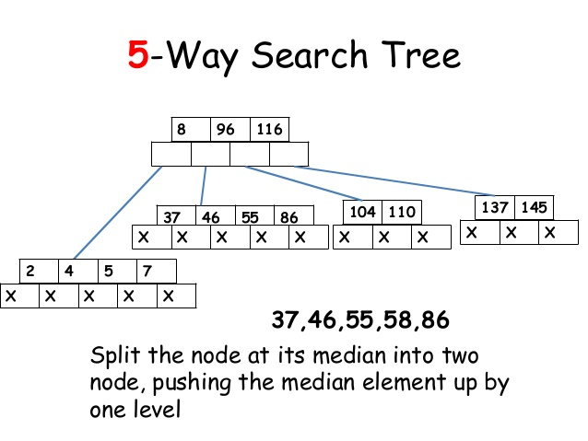

Slide 6
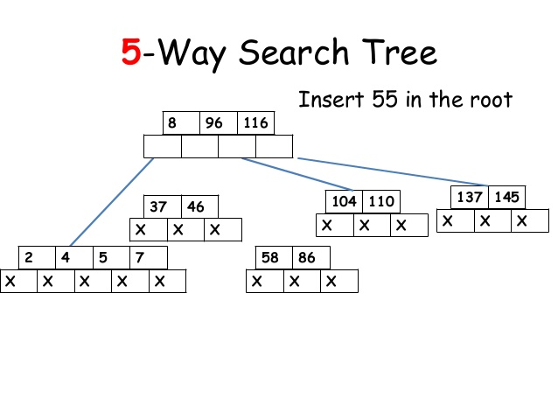

Slide 7
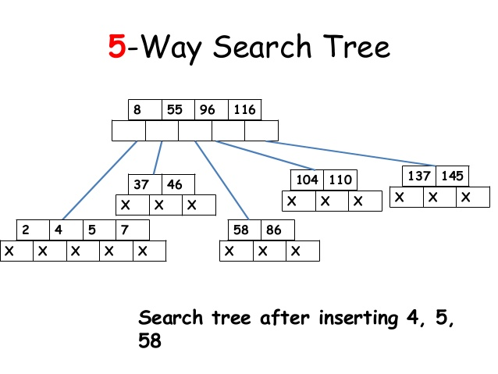

Slide 8
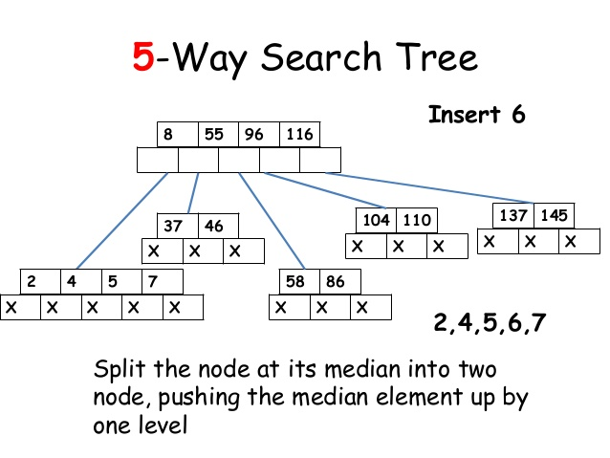

Slide 9
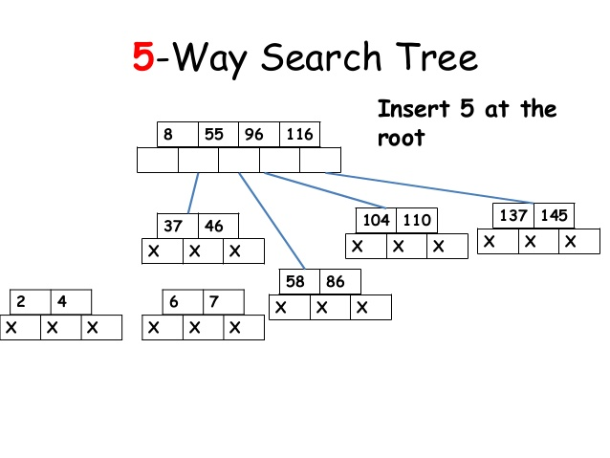

Slide 10
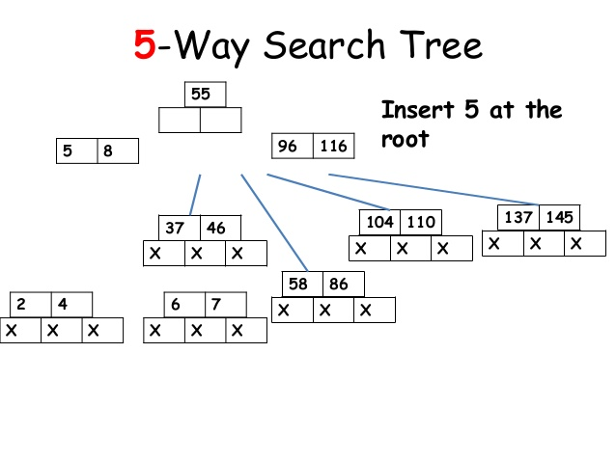

Slide 11
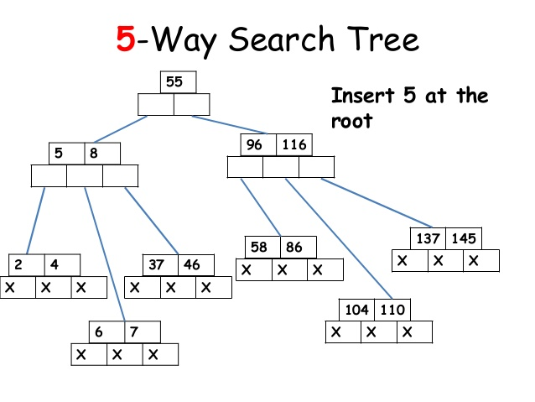

Slide 12
Deletion
Deletion is also performed at the leaf nodes. The node which is to be deleted can either be a leaf node or an internal node. Following algorithm needs to be followed in order to delete a node from a B tree.
1. Locate the leaf node.
2. If there are more than m/2 keys in the leaf node then
delete the desired key from the node.
3. If the leaf node doesn't contain m/2 keys then complete
the keys by taking the element from right or left sibling.

Slide 13
o If the left sibling contains more than m/2 elements then push its largest element up to its parent and move the intervening element down to the node where the key is deleted.
o If the right sibling contains more than m/2 elements then push its smallest element up to the parent and move intervening element down to the node where the key is deleted.
4. If neither of the sibling contain more than m/2 elements then create a new leaf node by joining two leaf nodes and the intervening element of the parent node.

Slide 14
5. If parent is left with less than m/2 nodes then, apply the
above process on the parent too.
If the the node which is to be deleted is an internal node, then replace the node with its in-order successor or predecessor. Since, successor or predecessor will always be on the leaf node hence, the process will be similar as the node is being deleted from the leaf node.
Example 1
Delete the node 53 from the B Tree of order 5 shown in the following figure.

Slide 15
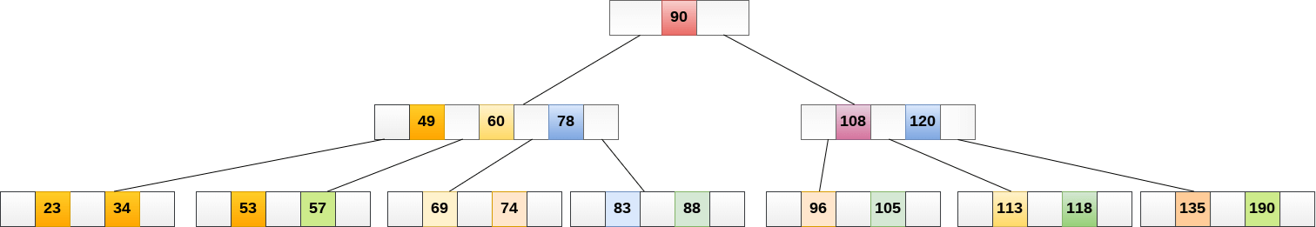

Slide 16
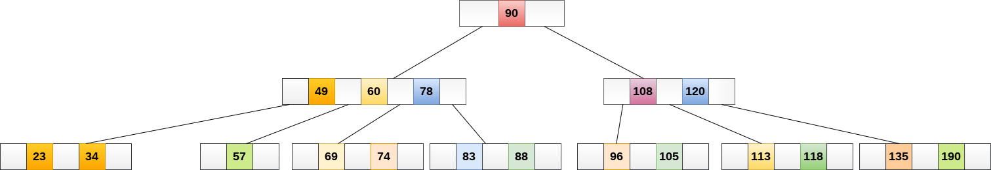
53 is present in the right child of element 49. Delete it.

Slide 17
Now, 57 is the only element which is left in the node, the minimum number of elements that must be present in a B tree of order 5, is 2. it is less than that, the elements in its left and right sub-tree are also not sufficient therefore, merge it with the left sibling and intervening element of parent i.e. 49.
The final B tree is shown as follows.

Slide 18
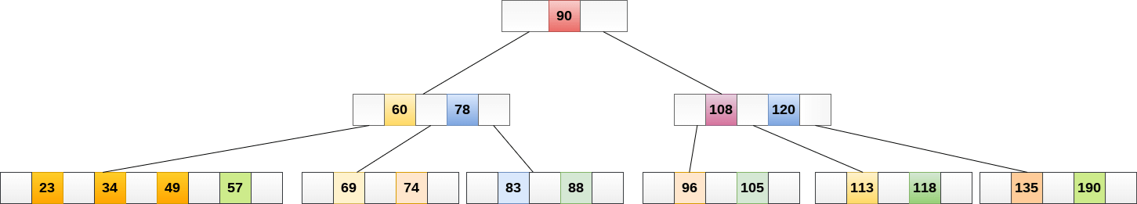

Slide 19
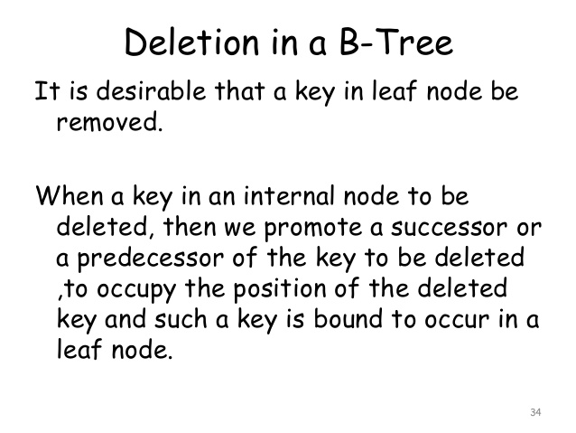

Slide 20
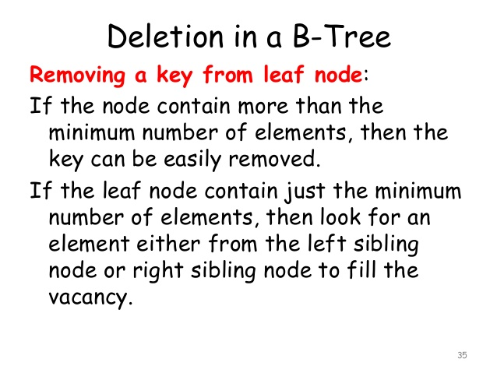

Slide 21
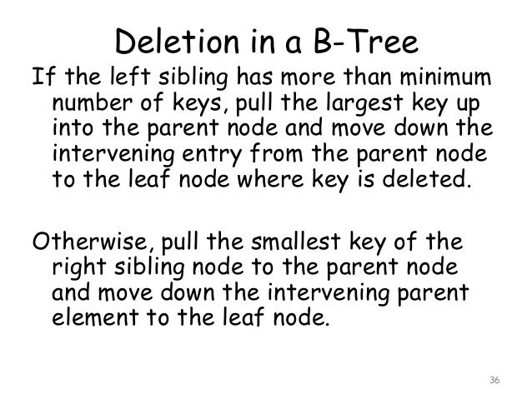

Slide 22
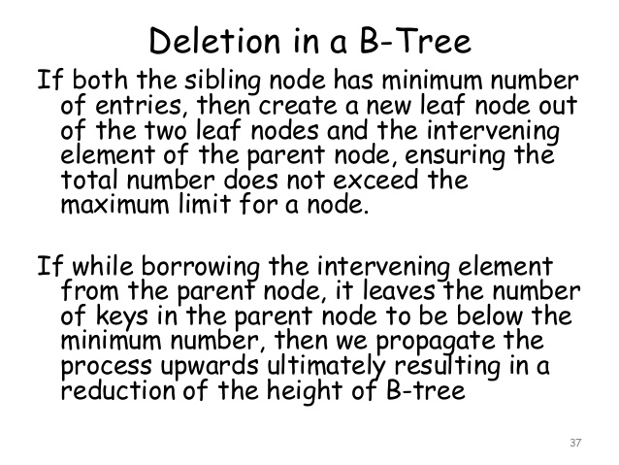

Slide 23
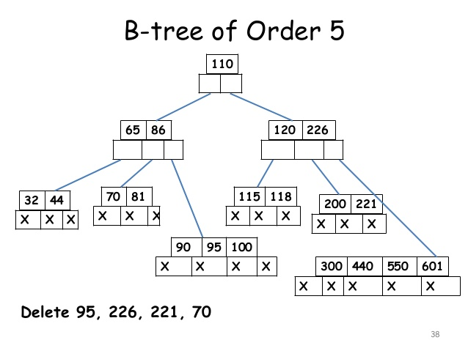

Slide 24
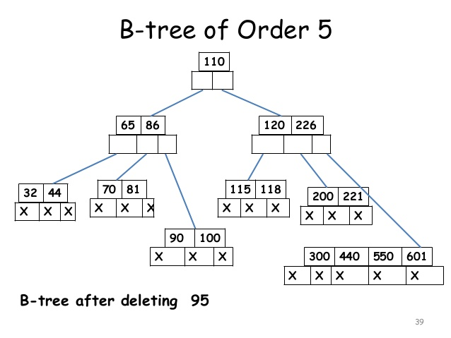

Slide 25
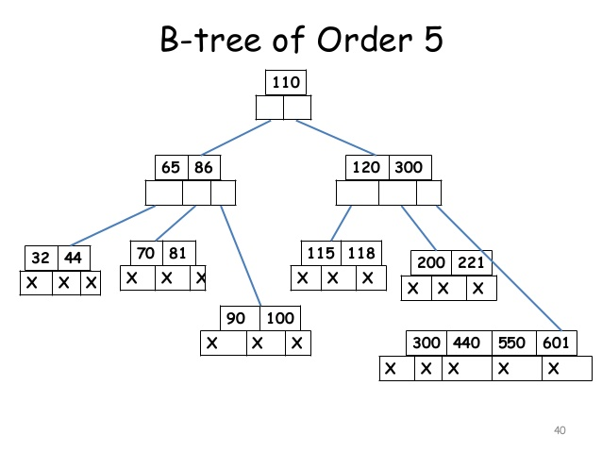

Slide 26
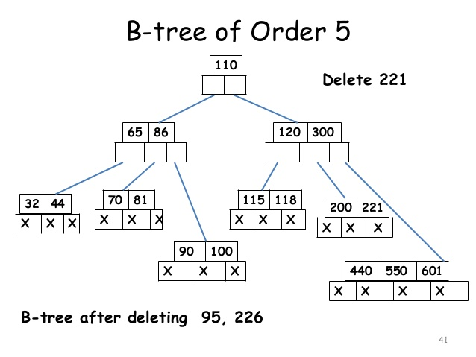

Slide 27
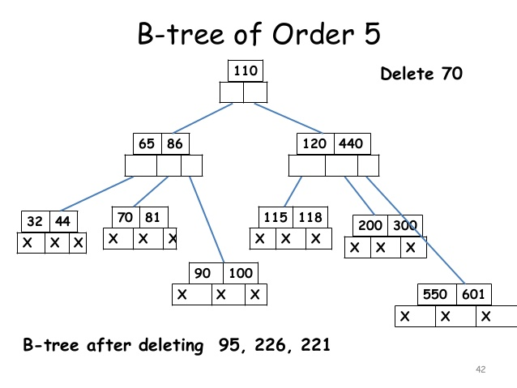

Slide 28
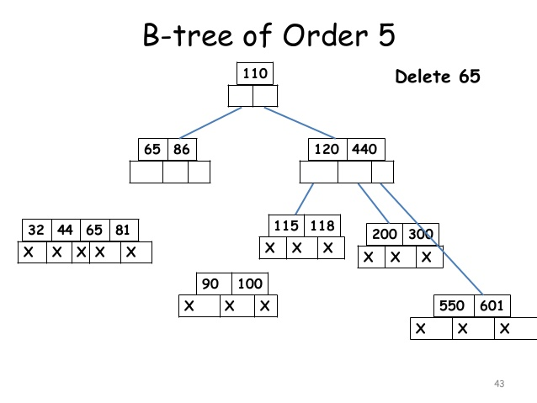

Slide 29
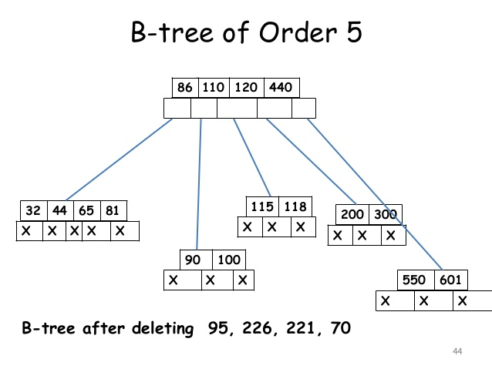

Slide 30
Application of B tree
B tree is used to index the data and provides fast access to the actual data stored on the disks since, the access to value stored in a large database that is stored on a disk is a very time consuming process.
Searching an un-indexed and unsorted database containing n key values needs O(n) running time in worst case. However, if we use B Tree to index this database, it will be searched in O(log n) time in worst case.

Slide 31
Thank You

